Slide 1
UDYOG SAARTHI
PIP4004 Capstone Project
Review-1
Batch Number: CSE_G138
Roll Number | Student Name
20211CSE0321 | RAHUL YADAV.B
20211CSE0503 | MOHANA RANGA.T
20211CSE0734 | SHAIK IRFAN
20211CSE0779 | BHARATH REDDY.B
20211CSE0769 | TEJESH REDDY
Roll Number | Student Name
Under the Supervision of,
Dr. KUPPALA SARITHA
Professor
School of Computer Science and Engineering
Presidency University
Name of the Program: CSE
Name of the HoD: Dr.Asif Mohammed H.B
Name of the Program Project Coordinator: Mr. Amarnath J.L & Dr. Jayanthi. K.
Name of the School Project Coordinators: Dr. Abdul Khadar A

Slide 2
Introduction
In recent years, the emphasis on inclusivity and equal opportunities for individuals with disabilities has gained significant momentum across various sectors. The Udyog Saarthi App emerges as a pivotal initiative aimed at empowering adults with disabilities by providing them with essential resources and support in their job search endeavors.
Purpose: Designed to support adults undergoing job coaching for employment opportunities under the 4% reservation policy.
Target Group: Focuses on individuals with disabilities, facilitating their access to job opportunities in various sectors.
Platform: A progressive web-based application that is accessible across multiple devices, enhancing user engagement.
Empowerment: Aims to empower users by providing essential resources and guidance for self-employment and job readiness.
Recognition: Lauded for its innovative approach during the Smart India Hackathon 2023, highlighting its social impact.

Slide 3
ABSTRACT
Despite progress in accessibility, education, and skills development, persons with disabilities (PwDs) in India continue to face significant challenges in securing employment. According to the Ministry of Statistics, 64% of PwDs remain unemployed, with the most vulnerable groups (D & E categories) struggling due to lack of awareness, inaccessible job notifications, and inadequate training support. This proposal outlines a software solution aimed at bridging this gap by providing accessible job information, training resources, tracking mechanisms, and workplace support. By collaborating with government bodies and NGOs, this initiative seeks to enhance employment opportunities, promote inclusion, and ensure dignified livelihoods for PwDs.
Keywords :- Employment, Accessibility, Disabilities, Inclusion, Training, Awareness .

Slide 4
Literature Survey
The employment landscape for individuals with disabilities has evolved significantly over the past few decades, driven by legislative reforms, social awareness, and technological advancements. Despite these positive changes, individuals with disabilities continue to face substantial barriers in securing meaningful employment. This literature survey aims to explore existing research, applications, and methodologies that address the challenges faced by this demographic in the job market.
Employment Challenges for Individuals with Disabilities:
Research indicates that individuals with disabilities often encounter systemic barriers that hinder their access to employment. These barriers include negative employer attitudes, lack of awareness about disability rights, inadequate training programs, and limited access to job opportunities.

Slide 5
Literature Survey
Reservation Policies and Their Impact:
Reservation policies play a crucial role in promoting employment opportunities for individuals with disabilities. In India, the government has implemented various policies aimed at reserving a specific percentage of jobs for persons with disabilities in public sector employment. The Rights of Persons with Disabilities Act (2016) mandates a 4% reservation in government jobs for individuals with disabilities.
Digital Applications as a Solution:
The advent of digital technology has opened new avenues for supporting individuals with disabilities in their job search efforts. Various applications have been developed to provide resources, training, and networking opportunities tailored to this demographic. A review by Singh et al. (2023) explores several digital platforms designed to enhance employability among persons with disabilities.

Slide 6
Objectives
The Udyog Saarthi App aims to empower adults undergoing job coaching by providing a seamless and accessible platform for securing employment under the 4% reservation policy in NIEPMD and other institutions. This Progressive Web Application (PWA) is designed to enhance accessibility and inclusion, ensuring that individuals with multiple disabilities can easily navigate job opportunities, skill development programs, and application processes.
Facilitate Job Coaching & Employment
Provide structured job coaching for adults seeking employment under the 4% reservation in NIEPMD and other institutions.
Enhance Accessibility & Inclusion
Ensure that individuals with multiple disabilities can easily access job opportunities, training resources, and support services.
Seamless Job Search & Application Process
Enable users to search for jobs, apply online, and track their application status.

Slide 7
Proposed Method Drawback
The Udyog Saarthi App, as a Progressive Web App (PWA), has several advantages, but it also comes with some drawbacks that should be considered when designing and implementing it. Here are the potential challenges:
1. Limited Native Features Support
PWAs lack full access to device-specific features like biometric authentication, Bluetooth, NFC, and advanced camera controls, which could be useful for accessibility features.
Certain OS restrictions (especially on iOS) limit background processes and push notifications, which could impact engagement.
2. Performance Issues
Offline functionality is dependent on caching via Service Workers, and large-scale data handling can be slower than native apps.
Heavy animations or real-time features (e.g., live video training) may not run as smoothly compared to a native application.
3.Offline Mode Limitations
While PWAs support offline mode, dynamic content like job listings or real-time chat support may not function without an internet connection.
Users in rural or low-network areas may face accessibility issues if caching is not properly optimized.

Slide 8
Proposed Method Drawback
4. iOS Restrictions
Apple limits PWA functionality by not supporting push notifications and background sync as effectively as Android.
Limited storage quota for offline data, which may affect job coaching content availability.
5. Security Concerns
PWAs run in web browsers, making them more susceptible to security vulnerabilities than native apps.
Limited control over device security features, like secure storage and biometric authentication.
6. Dependency on Browser Support
Different browsers may have inconsistent PWA support (especially on older versions).
Some accessibility features might not work optimally across all browsers and devices.
7. User Adoption and Awareness
Many users, especially those undergoing job coaching, may not be familiar with PWAs, leading to low adoption rates without proper training.
Unlike native apps, PWAs do not appear directly in major app stores (except via workarounds like Google Play Trusted Web Activities).

Slide 9
Methodology/Modules
The methodology of the Udyog Saarthi App follows a structured and inclusive approach to facilitate job coaching and employment opportunities under the 4% reservation policy. The development process begins with requirement analysis, identifying the key challenges faced by individuals with disabilities in accessing job opportunities. Based on these insights, the app is designed as a Progressive Web Application (PWA) to ensure cross-platform accessibility, offline functionality, and assistive technology integration such as screen readers, voice navigation, and multilingual support.
1. Requirement Analysis & Research
Conduct surveys and interviews with job seekers, NIEPMD representatives, and employers to understand challenges in the current job search process.
Identify accessibility needs such as screen readers, voice navigation, and multilingual support.
2. System Design & Architecture
Develop a Progressive Web App (PWA) architecture to ensure cross-platform compatibility, offline access, and real-time updates.
Implement a user-friendly and accessible UI/UX designed for people with disabilities.
Design a centralized database for job postings, applications, and coaching resources.

Slide 10
Methodology/Modules
3. Development & Implementation
Front-End Development: Build an interactive, responsive, and accessible PWA interface using modern web technologies.
Back-End Development: Implement secure databases, AI-powered job recommendations, and real-time job tracking.
Assistive Technology Integration: Ensure compatibility with screen readers, voice commands, text-to-speech, and easy navigation.
4. Continuous Monitoring & Enhancement
Collect user feedback and implement improvements for better usability.
Update job listings and skill training modules regularly.
Expand features like AI-driven career counseling, video interviews, and employer reviews.

Slide 11
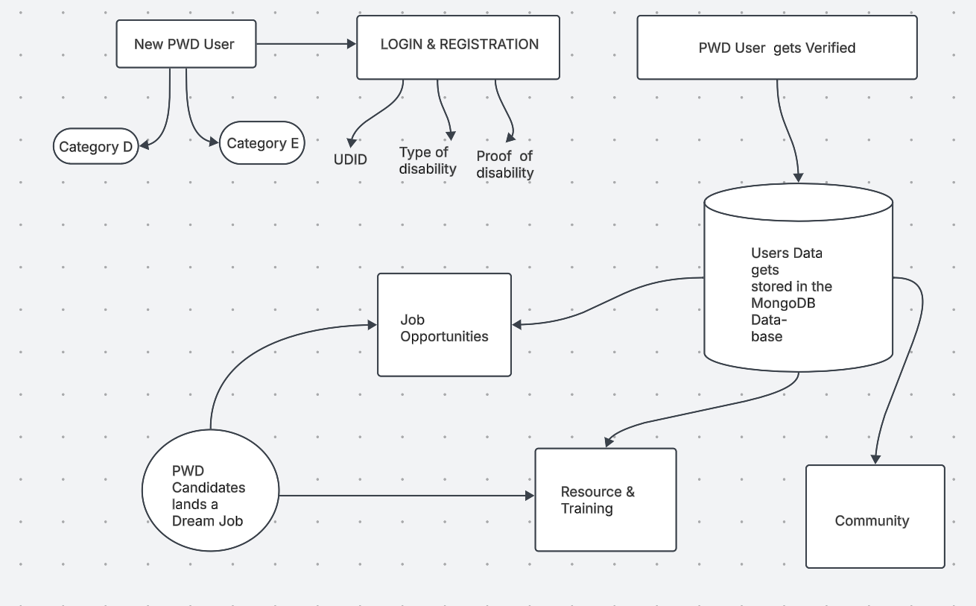
Architecture

Slide 12
Hardware/software components
Hardware Components
These are the essential physical components required to support the development, hosting, and usage of the Udyog Saarthi App.
Server Infrastructure:
Cloud-based servers (e.g., AWS, Google Cloud, Microsoft Azure) for hosting databases, APIs, and job listings.
Load balancers to manage high traffic and ensure uptime.
User Devices:
Smartphones (Android) – Ensuring mobile accessibility.
Laptops & Desktops – Supporting web-based access.
Tablets – Optimized for users preferring larger screens.
Network Infrastructure:
Wi-Fi / Mobile Data – Stable internet connectivity for accessing job portals.
Content Delivery Network (CDN) for faster app performance worldwide.

Slide 13
Hardware/software components
Software Components
These are the key technologies used to develop and run the Udyog Saarthi Progressive Web Application.
Front-End Technologies (User Interface Development)
HTML5, CSS3, JavaScript (React.js, Angular, or Vue.js) – Responsive and accessible UI.
Progressive Web App (PWA) Framework – Enabling offline mode and push notifications.
Bootstrap / Tailwind CSS – For a mobile-friendly and visually appealing design.
Back-End Technologies (Server & Database Management)
Python with Django – Backend logic and API development.
Database (MongoDB) – Storing job listings, user profiles, and applications.
Cloud & Hosting Services
AWS S3 / Firebase Storage – For storing resumes and job-related documents.
Google Cloud / Azure App Services – Scalable cloud hosting for app deployment.
Push Notification Service (Firebase Cloud Messaging) – Sending job alerts and updates.

Slide 14
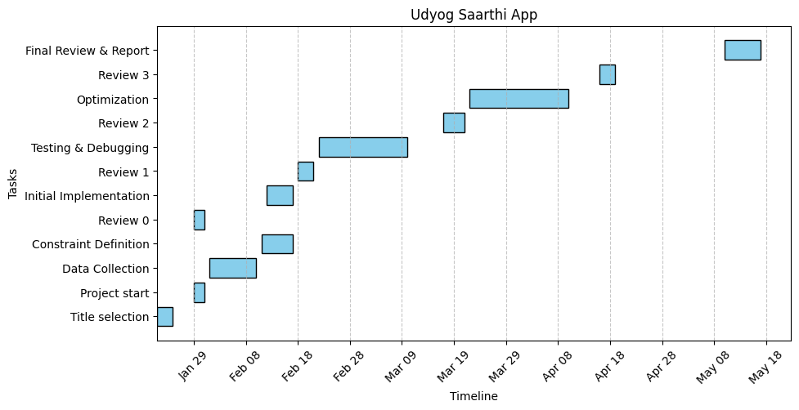
Timeline of Project

Slide 15
Conclusion
The Udyog Saarthi App is designed as an inclusive and accessible Progressive Web Application (PWA) to support adults undergoing job coaching under the 4% reservation policy in NIEPMD and other institutions. By integrating assistive technologies, personalized job coaching, and real-time job tracking, the platform effectively addresses the limitations of existing methods.
With a focus on accessibility, efficiency, and ease of use, the app leverages modern web technologies, cloud-based infrastructure, and AI-driven recommendations to bridge the gap between job seekers and employment opportunities. The implementation of PWA features such as offline access, push notifications, and cross-platform compatibility ensures that users can stay updated on job listings and career development resources seamlessly.
Through collaboration with government agencies, training institutes, and employers, Udyog Saarthi has the potential to revolutionize job placement for individuals with multiple disabilities, fostering economic empowerment and social inclusion. By continuously enhancing the platform based on user feedback and technological advancements, this initiative will play a vital role in ensuring sustainable employment opportunities for the targeted beneficiaries.

Slide 16
Github Link
The Github link provided should have public access permission.
Github Link
https://github.com/rahulyadav00325/udyog-saarthi-app.git

Slide 17
References
Ministry of Statistics and Programme Implementation (MoSPI), Government of India. (Latest Report on Persons with Disabilities in India)
Provides statistical data on employment rates and challenges faced by PwDs in India.
The Rights of Persons with Disabilities (RPwD) Act, 2016.
Legal framework governing employment rights, reservations, and accessibility provisions for PwDs.
Department of Empowerment of Persons with Disabilities (DEPwD), Government of India.
Policies, job reservation schemes, and initiatives supporting PwD employment.
National Institute for Empowerment of Persons with Multiple Disabilities (NIEPMD).
Research, training programs, and job coaching services for PwDs in India.
International Labour Organization (ILO) Reports on Disability and Employment.

Slide 18


